Slide 1
IMAGE OPERATIONS

Slide 2
filter
Filter term in “Digital image processing” is referred to the subimage.
There are others term to call subimage such as mask, kernel, template, or window.
The value in a filter subimage are referred as coefficients, rather than pixels.

Slide 3
Spatial filtering
Spatial filtering is a technique that uses a pixel and its neighbors to select a new value for the pixel.
Spatial filtering term is the filtering operations that are performed directly on the pixels of an image
Steps in spatial filtering
  Defining a center point.
  Performing operation in a predefined neighborhood about the center point.
  Replace the center point by the result of operation.
  Repeat the process for every pixel in the image.

Slide 4
Linear filtering
Origin
x
a
b
c
r
s
t
d
e
f
*
u
v
w
g
h
i
x
y
z
Original Image Pixels
Filter
Simple 3*3
Neighbourhood
e
3*3 Filter
e_{processed} = v*e +
r*a + s*b + t*c +
u*d + w*f +
x*g + y*h + z*i
y
Image f (x, y)
Linear operations consist of multiplying each pixel in the neighborhood by a corresponding coefficient and summing the results to obtain the response at each point(x.y).

Slide 5
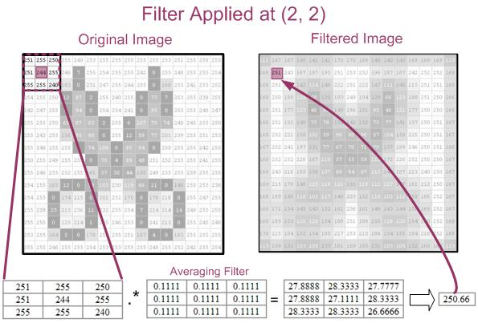

Slide 6
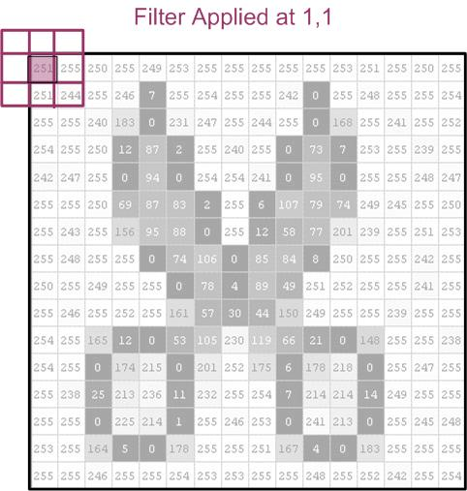

Slide 7
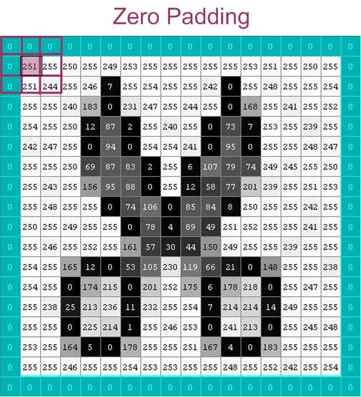

Slide 8
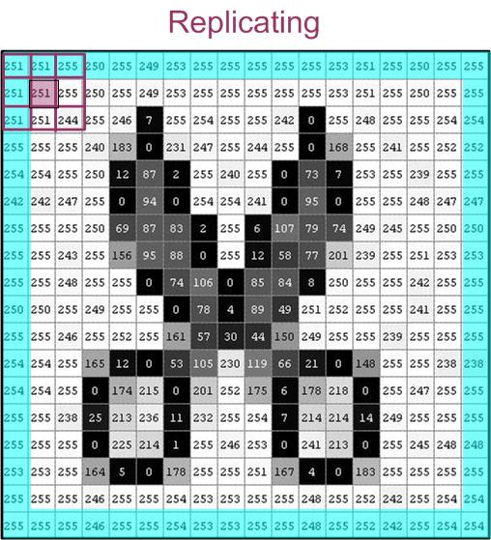

Slide 9
TYPES OF FILTERS
Two types of filters:
  Smoothing Filters
  Sharpening Filters

Slide 10
TYPES OF FILTERS
Two types of filters:
  Smoothing Filters
  Sharpening Filters

Slide 11
Smoothing Spatial Filters
Smoothing filters are used for blurring and for noise reduction.
  Blurring is used in preprocessing steps, such as removal of small details from an image prior to object extraction.
  Noise reduction can be accomplished by blurring

Slide 12
Average Smoothing Filters
The idea is replacing the value of every pixel in an image by the average of the gray levels in the neighborhood defined by the filter mask.

Slide 13
Two 3x3 Smoothing Filters
1
1
1
1
2
1
1
1
1
2
4
2
1
1
1
1
2
1
Standard average
Weighted average

Slide 14
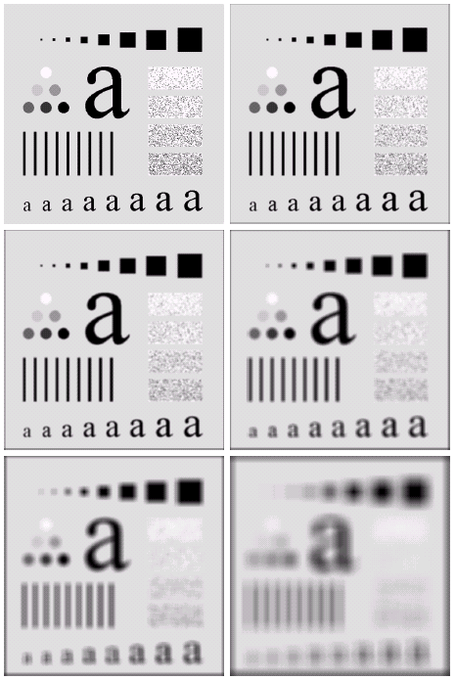
Smoothing Spatial Filtering _ Linear
Averaging (low-pass) Filters
n = filter size
n = 3
n = 5
n = 9
n = 35
n = 15

Slide 15
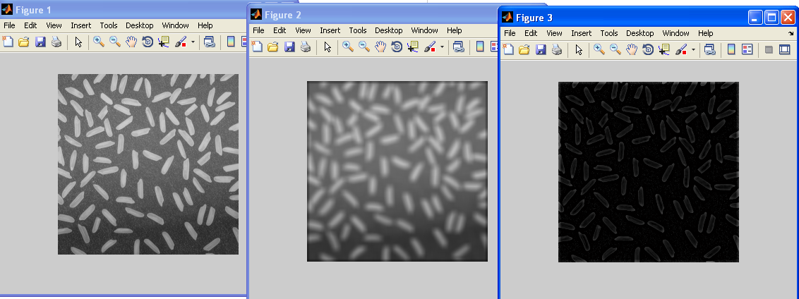
Smoothing Spatial Filtering
Averaging (low-pass) Filters
close all;
r= imread('rice.png');
figure,imshow(r);
f=fspecial('average',[9]);
g=imfilter(r,f);
figure,imshow(g);
u=r-g;
figure,imshow(u);

Slide 16
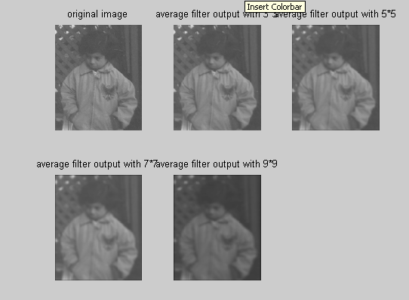
close all;
a=imread('pout.tif‘);
w=[1/9 1/9 1/9; 1/9 1/9 1/9; 1/9 1/9 1/9]
b=imfilter(a,w);
w1=[1/25 1/25 1/25 1/25 1/25;
1/25 1/25 1/25 1/25 1/25;
1/25 1/25 1/25 1/25 1/25;
1/25 1/25 1/25 1/25 1/25;
1/25 1/25 1/25 1/25 1/25]
b1=imfilter(a,w1);
w2=[1/49 1/49 1/49 1/49 1/49 1/49 1/49;
1/49 1/49 1/49 1/49 1/49 1/49 1/49;
1/49 1/49 1/49 1/49 1/49 1/49 1/49;
1/49 1/49 1/49 1/49 1/49 1/49 1/49;
1/49 1/49 1/49 1/49 1/49 1/49 1/49;
1/49 1/49 1/49 1/49 1/49 1/49 1/49;
1/49 1/49 1/49 1/49 1/49 1/49 1/49]
b2=imfilter(a,w2);
w3=[1/81 1/81 1/81 1/81 1/81 1/81 1/81 1/81 1/81;
1/81 1/81 1/81 1/81 1/81 1/81 1/81 1/81 1/81;
1/81 1/81 1/81 1/81 1/81 1/81 1/81 1/81 1/81;
1/81 1/81 1/81 1/81 1/81 1/81 1/81 1/81 1/81;
1/81 1/81 1/81 1/81 1/81 1/81 1/81 1/81 1/81;
1/81 1/81 1/81 1/81 1/81 1/81 1/81 1/81 1/81;
1/81 1/81 1/81 1/81 1/81 1/81 1/81 1/81 1/81]
b3=imfilter(a,w3);
figure(1);
subplot(2,3,1);
imshow(a);
title('original image');
subplot(2,3,2);
imshow(b);
title('average filter output with 3*3');
subplot(2,3,3);
imshow(b1);
title('average filter output with 5*5');
subplot(2,3,4);
imshow(b2);
title('average filter output with 7*7');
subplot(2,3,5);
imshow(b3);
title('average filter output with 9*9');

Slide 17
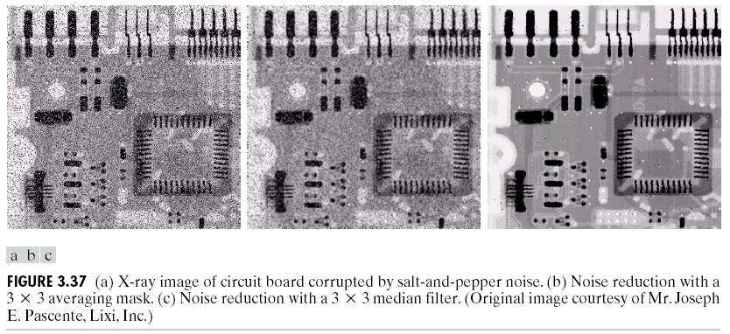
Smoothing Spatial Filtering
Order Statistic Filters
3 × 3 Median filter [10 125 125 135 141 141 144 230 240] = 141
3 × 3 Max filter [10 125 125 135 141 141 144 230 240] = 240
3 × 3 Min filter [10 125 125 135 141 141 144 230 240] = 10

Slide 18
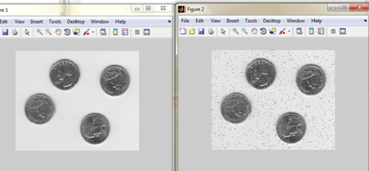
Smoothing Filters: Median Filtering
I = imread('eight.tif');
J = imnoise(I,'salt & pepper',0.02);
figure, imshow(I)
figure, imshow(J)

Slide 19
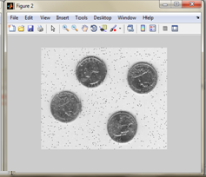
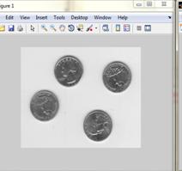
Smoothing Filters: Median Filtering
I = imread('eight.tif');
J = imnoise(I,'salt & pepper',0.02);
K = medfilt2(J);
imshow(J);
figure, imshow(K);

Slide 20
TYPES OF FILTERS
Two types of filters:
  Smoothing Filters
  Sharpening Filters

Slide 21
Sharpening Spatial Filters
The principal objective of sharpening is to
  Highlight fine detail in an image
  To enhance detail that has been blurred

Slide 22
Unsharp masking
A process to sharpen images consists of subtracting a blurred version of an image from the image itself. This process, called unsharp masking, is expressed as
Where denotes the sharpened image obtained by unsharp
masking, and is a blurred version of

Slide 23



Sharpening Filters: Unsharp Masking
Obtain a sharp image by subtracting a lowpass filtered image from the original image:
a=imread('cameraman.tif');
h=fspecial('unsharp');
b=imfilter(a,h);
imshow(a);
figure,imshow(b);
-
=
'average‘, 'gaussian‘, 'laplacian‘, ‘disk‘, 'motion‘, 'sobel‘, unsharp'

Slide 24
Thank You

